Slide 1


“Sustainable and quality long term care services”
Managing dementia in long term care: the Australian perspective
Susan Kurrle
Geriatrician
Hornsby Ku-ring-gai and Eurobodalla Health Services
Curran Professor in Health Care of Older People,
Faculty of Medicine, University of Sydney
Director, NHMRC cognitive decline partnership Centre
susan.kurrle@sydney.edu.au
1st Dec 2018

Slide 2
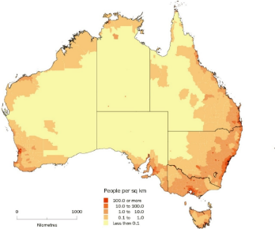

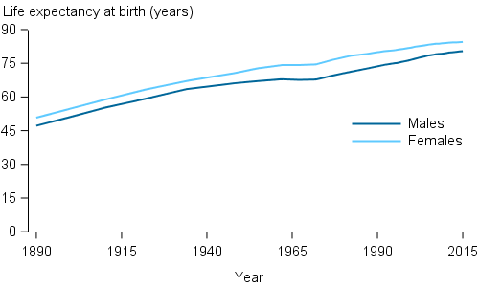
Australia 2018
Australian population: 25 million
Multicultural: from > 160 countries, > 100 different languages spoken
15.2% aged 65 years and over in 2018
    22% aged 65 years and over by 2056
    Increasing numbers of people living to 85 years and beyond
Life expectancy continues to increase
    Men 81 years
    Women 85 years
Causes of death:
  Women:
    Dementia
    Ischaemic heart disease
  Men:
    Ischaemic heart disease
    Dementia

Slide 3
Dementia in Australia
2018: 400,000 + people with dementia
2050: 900,000 people with dementia
at age 65: 1 in 12 people have dementia
at age 85: 1 in 3 people have dementia
highest cause of disability in >65 years group
Alzheimers disease is most common cause of dementia followed by vascular/mixed dementia
approx 25,000 people under age 65 with dementia
The imperative of dementia:
    Unknown cause for AD and no cure
    Incidence increases with age
    We need to have good models of care to manage the increasing numbers of older people with dementia

Slide 4
Long term care in australia
Long term care includes community based aged care provided in an older person’s home or community centre, and residential aged care
80% of older people use some form of long term care
Aged care is subsidised for all Australians, and is funded by the Australian government with the older person paying part of the cost according to their income and assets
AU$17.5 billion was spent on long term care in 2016/7 and 997,000 people used some long term care services
The Australian Government changed the method of funding of aged care to improve its sustainability in 2015. There is an increased emphasis on the older person paying more of the costs of care.
There is also a large private sector (user pays all costs) for aged care
There is no long-term care insurance in Australia
www.myagedcare.gov.au

Slide 5

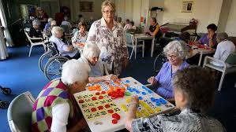
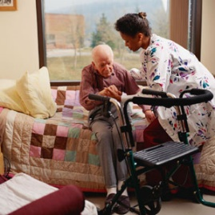

Long term care in Australia
All older people needing long term care require an assessment from an Aged Care Assessment Team. This is accessed through My Aged Care entry point
Community care
Commonwealth Home Support Program provides government funded low level assistance (housekeeping, transport, home delivered meals, day activity centres, occupational and physiotherapy home visits)
Commonwealth Aged Care Packages levels 1- 4 provide in home services including personal care, respite, transport, cleaning, cooking, with the aim of reducing the need to move to residential care
Older person holds the budget for the care, and chooses an aged care provider
Care is “consumer directed” (older person chooses services they need)
www.myagedcare.gov.au

Slide 6
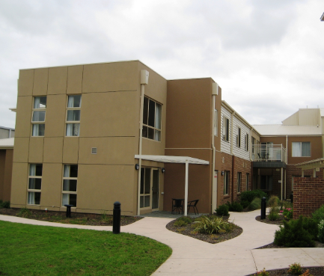
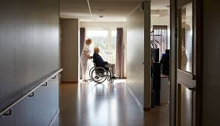
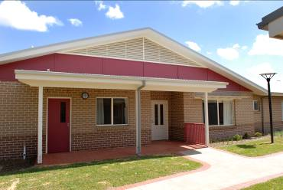
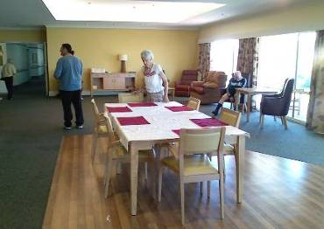
Long term care in australia
Residential care
Respite care – high or low level – for up to 63 days in the year
Permanent care
In residential care age pensioners with no or minimal other income or assets pay 85% of their pension with no other costs required
Residents with higher assets and income pay according to their assessed income

Slide 7
Long term care in dementia
Approximately 55% of older people receiving community care have cognitive impairment or dementia
Approximately 65% of older people in residential care have cognitive impairment or dementia (approx. 110,000)
Very heterogeneous group ranging from younger physically fit people with dementia to very frail older people with dementia, with a range of cognitive and behavioural issues, and associated medical problems
    Many residential care facilities are fully dementia specific, some have dementia specific sections which are secure (need key or code to go in or out)
    Specialist Dementia Care Units available for people with dementia who cannot be managed in standard facilities (usually with severe Behavioural and Psychological Symptoms of Dementia)

Slide 8
Long term care in dementia:
Special considerations
Community care
Lack of insight into needs, refusal to accept services, lack of recollection of agreement to services, accusing care staff of stealing items, difficulties particularly in late afternoon, wandering away from home, not attending to personal care, leaving stove on, burning food, eating stale food……….
Care is consumer directed and requires person with dementia to make choices about care. This may be difficult
Residential care
Severe disorientation in unfamiliar environment, feelings of abandonment, accusations at family, lack of insight into needs, forgetting reason for move to LTC (eg death of spouse), wandering away (elopement) from facility
Agitation and aggression towards care staff and towards other residents

Slide 9
Long term care in dementia
Recent Australian research comparing a domestic or homelike model of care to traditional residential aged care facilities has shown most appropriate model of care for people with dementia is domestic or homelike model of care
      Higher quality of life
      Higher quality of care
      Lower psychotropic medication use (OR 0.24)
      Lower presentations to hospital (RR 0.32)
      Lower overall annual costs (approx. AU$13,000/year)
What was important to residents:
      Small size (< 15 residents)
      Access to outside areas independent of staff
      Staff member allocated to resident to provide continuity of care
      Meals prepared in the unit kitchen
      Residents assist in meal preparation
      Residents assist in other daily activities eg laundry, gardening

Slide 10
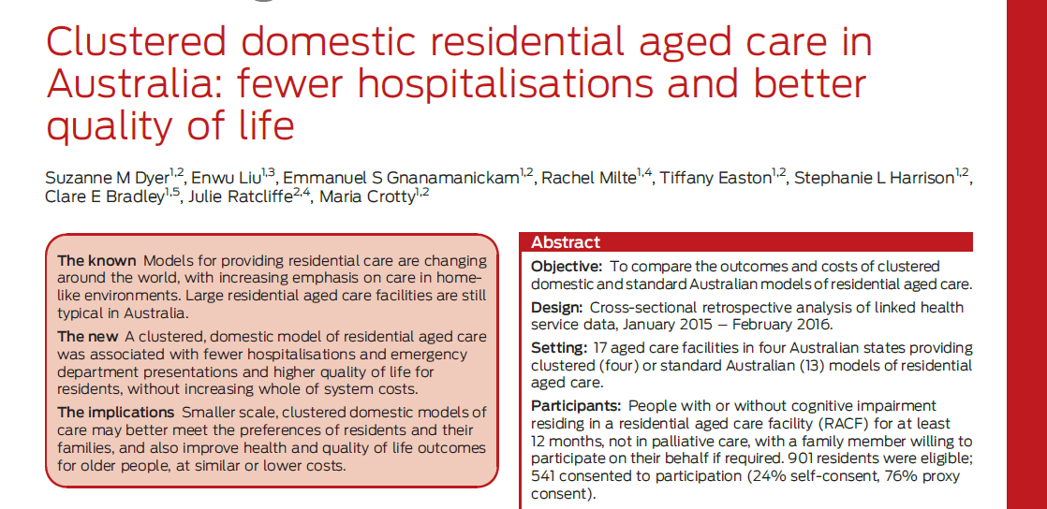
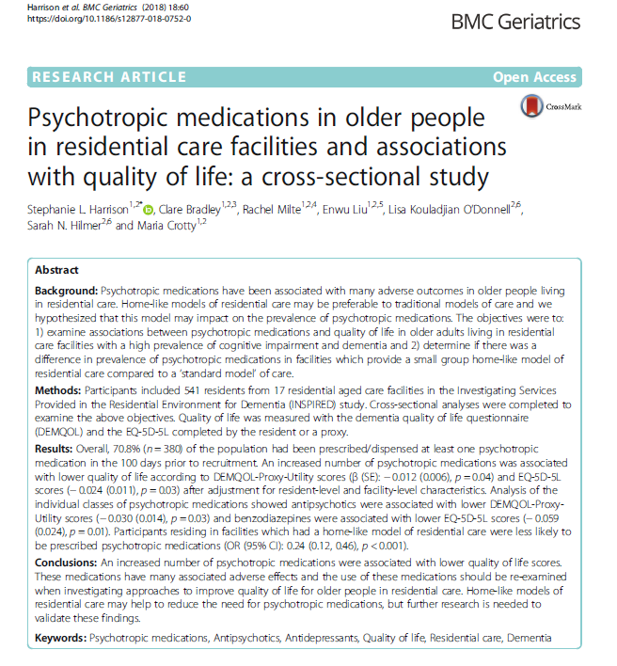

Slide 11
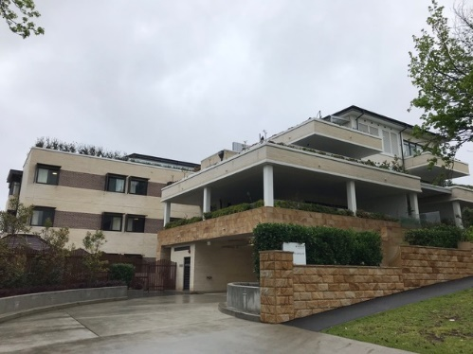
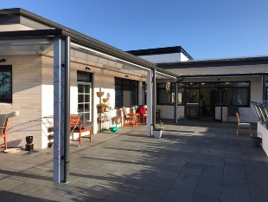
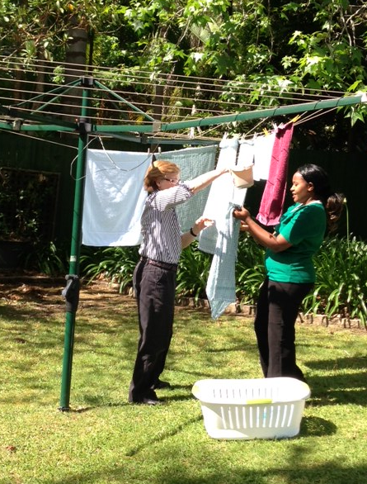
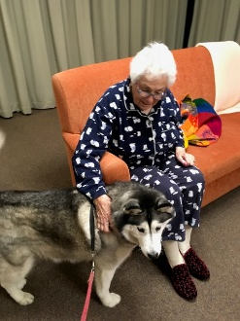
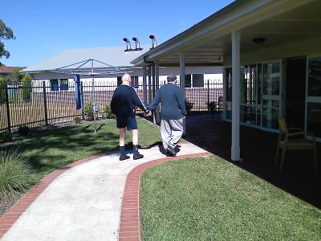
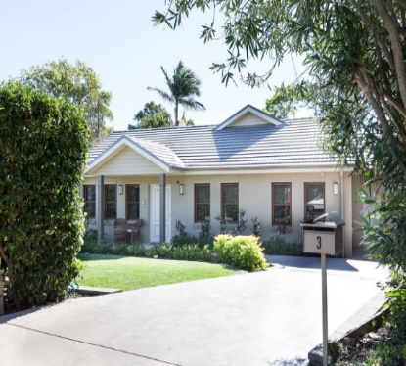
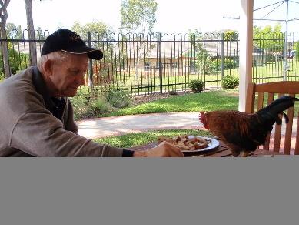
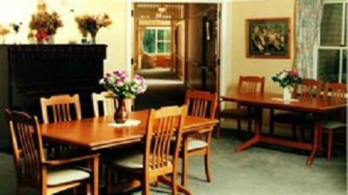
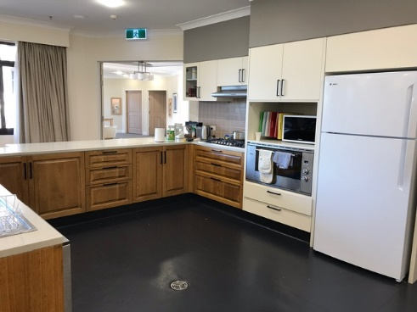
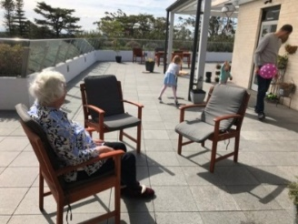
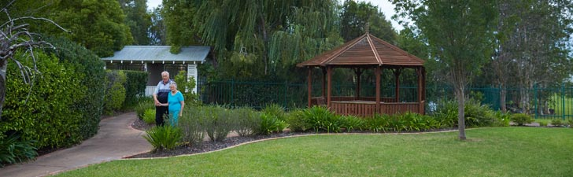
Long term care in dementia domestic model of care

Slide 12
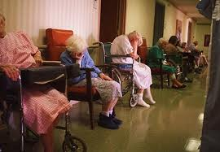
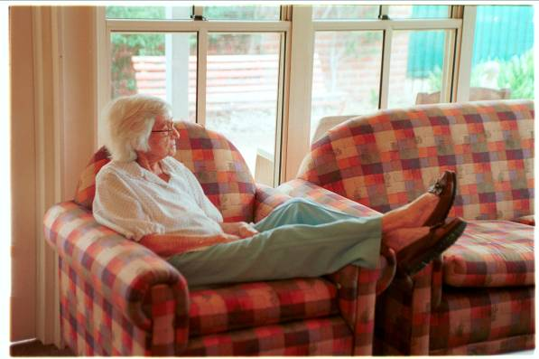
Which would you prefer?

Slide 13

Long term care in dementia:
Mrs B
Lives alone in own home in suburban Sydney, has hypertension and Type 2 diabetes, daughter lives 2 hours drive away, telephones regularly
Aged 78: had early dementia (Alzheimer’s disease) diagnosed, continued to manage independently except for assistance with house cleaning
Aged 79: began to forget to take medication, so GP and daughter arranged for home nurse to visit each morning to administer tablets and check blood pressure and blood sugar levels weekly
Aged 80: Stopped driving because became erratic on the road, bumped into garage wall.
Daughter arranged for referral to Aged Care Assessment Team for advice and approval for home assistance for shopping and cooking

Slide 14
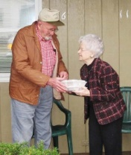

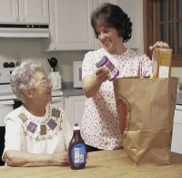
Long term care in dementia:
Mrs B
ACAT approved her for Level 2 package (4 hours per week) and home delivered meals and social support.
Daughter found an aged care provider that seemed to understand her mother’s needs. There was a co-payment of $6 per week as Mrs B on an age pension
Carer took her shopping once weekly, and visited 2 days a week for shopping and clothes washing. She attended a day centre 2 days a week where there was physical exercise and games.
Aged 82: continued to manage at home with Level 3 package with visits increased to 5 days a week and 10 hours of care per week including 5 days of home delivered meals

Slide 15
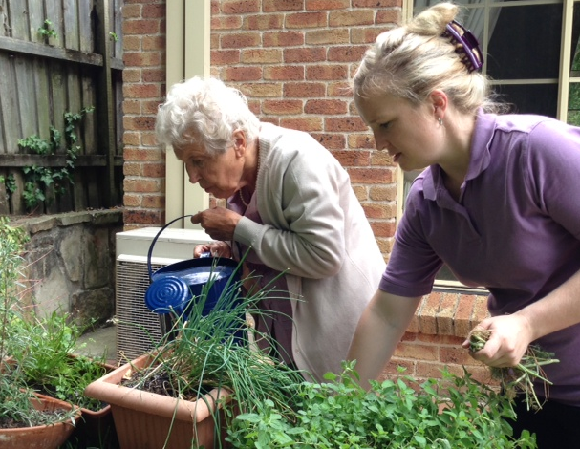
Long term care in dementia:
Mrs B
Aged 84: became occasionally incontinent, having trouble making her breakfast, and fell several times both in the house and in the garden
Daughter stayed with her for several weeks but realised that her mother needed 24 hour supervision and care
Aged 84: moved to domestic model residential care facility near daughter. Very unsettled initially and daughter and grandchildren spent much of each day with Mrs B, brought in familiar furniture and photographs, reassured her
Settled in gradually and began to help with meal preparation and hanging out washing, and enjoyed garden and going for walks with care staff

Slide 16
Long term care in dementia:
Mr t
Aged 63: diagnosis of Alzheimer’s disease whilst still working as accountant, commenced on donepezil, gradually handed over his clients to his partner and retired at age 64
Aged 65: becoming agitated at home, wanting to go out for walks and go swimming, wife concerned he would get lost on his own
Referred to ACAT who approved him for a Level 2 package
First aged care provider declined to take him out walking, wife found a provider who would go walking and swimming, and Mr T was happy with this
As Mr T was self funded, he paid for the full cost of the carer
Aged 67: wife became more stressed by husband’s constant need for reassurance about where they lived and what was happening to his money, and his constant requests to go back to work. She did not feel able to cope any longer

Slide 17
Long term care in dementia:
Mr t
Aged 67: moved to residential care. Extremely agitated by the move and constantly trying to leave, harassing staff and relatives to leave, climbed 2 metre high fence
Individual carer arranged to keep Mr T occupied, taking him swimming, walking and to the shops. Also trial of medication with no benefit (citalopram)
Aged 68: began running away from carer when out walking or shopping to look for wife, convinced she was having an affair
Trial of medication (risperidone) to reduce delusions and aggression and became slow and falling over, staff declined to continue giving him medication
Specialist dementia team recommended transfer to Specialist Dementia Care Unit

Slide 18
Long term care in dementia:
Mr t
Aged 68: moved 200 kms away from his wife to specialist unit. Given 1:1 attention and exercise, medication reduced. Stayed there for 10 months
Aged 69: moved back to original aged care facility, on minimal medication. Much quieter and slower, now enjoys watching football, going for short walks and eating fish and chips

Slide 19
The future for long term care
How do we afford to pay for this care into the future?
What will the “Baby Boomers” be happy to pay for?
What will our children and grandchildren be happy to pay for?
We need to consider more interventions in middle age to postpone the development of dementia and frailty in older age

